Slide 1
Wrong Parking Detection Project
Using AI (Image Processing) based approach to detect wrong parking of vehicles (Cars) from a video (CCTV).
Rao Noor ul Amin
M Saqlain
Ibtasam Ahmad
Mudasser Habib

Slide 2
f
ABSTRACT
WRONG PARKING DETECTION (PIXEL BASED)
ALPR (ATOMATIC LICENCE PLATE REGOGNIZATION
Data Mining
Video capturing of a parking lot
Preprocessing
Image Blur
Detection
Parking detection on the basis of pixels (Occupied/Vacant and Wrong Parked)
Number plate detection on the basis cascade training
Binary Image
Co-ordinates of parked car
Resizing of image
Data Mining
Preprocessing
Cascade Model Training
Detection
Data set of number plates
Data set of cars
Detection on the basis of trained model
Vacant
Occupied
Wrong Parking
Number Plate Detection
No Number Plate Detection

Slide 3
Problems
With the high percentage of vehicle ownership in the Pakistan, parking has become a conflicting and confusing situation for the people.
Cars are parked everywhere in a reckless manner around us which has become the root cause of all the major parking issue.
With the growing number of vehicles, this problem of wrong parking is increasing day by day.
Even if the cars are parked wrong there are no measurements taken in order to curb it. Not much people are fined and therefore keeps on parking illegally.
People don’t know about the rules that whether to park a car at a particular location or not and in turn park anywhere they like causing traffic jams and even accidents in some cases.

Slide 4
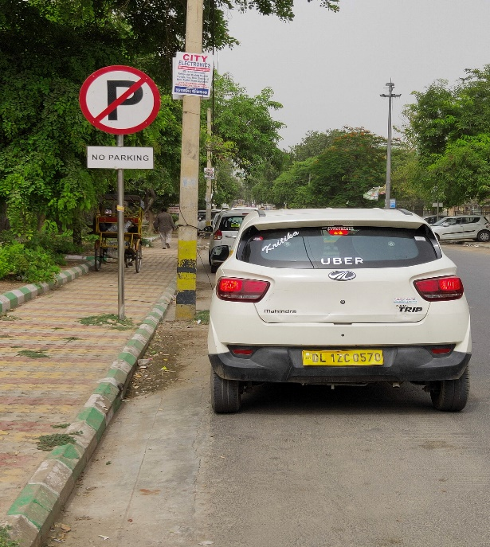
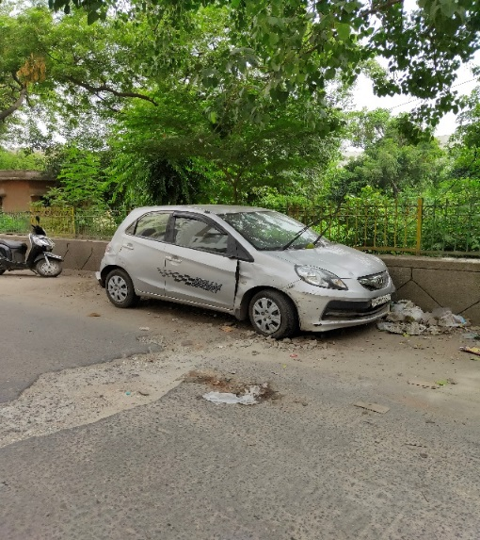
Wrong parking images

Slide 5
Idea behind the project
The main idea behind this project is to handle this growing problem of wrong parking using Artificial Intelligence.
We’ve tried applying Image Processing technique’s in order to tell whether the parked car is legal or illegal.
Our model will classify the cars from the vedios by the users into three different categories that is, occupied, vacant and wrong parked cars using image processing .

Slide 6
Dataset Used
Collecting data was one of the most challenging and time consuming part of this project.
We’ve tried to collect data from all the different locations including a parking lot..
It was the most challenging and difficult part of this project as to check what type of cars are pared wronged or right.
If wrong parking the model will tell the number of the wrong parked car detected.
We’ve first collected the images and then have applied image augmentations in order to increase the number of images in the dataset which are later used in cascade model training.

Slide 7
Our Project
Using AI based approach to detect wrong parking of vehicles (Cars) from a video
Our model will receive a video of parked car through the user of the app , then our model will try to predict the status of parking based on the background details (wrong parked or right parked).
Our model will do the prediction for each car that ids wronged parked and also detect the number plate of the wrong parked car.

Slide 8
Model Architecture
It consists of cascade model by image number plate is predicted
It consists on pixel based model to tell wrong or right parking

Slide 9
Right Parked

Slide 10
Wrong Parked

Slide 11
Benefits
This will be beneficial for not just the parking areas but also the common people to check and fined a place to parked their car.
It is a cost effective way of categorizing whether the car should be fined or not.
It requires only the videos of the parked car in order to classify it as wrong, occupied and vacant which makes it robust and easily manageable.
It will create a sense of awareness and responsibility among the citizens in order to park their cars properly and also for the government to make more and more legal parking spots.

Slide 12


